Slide 1
Developing Quantum Computing Circuits
Optics and Spectroscopy
Sofia University
Vasil Yordanov and Lachezar Georgiev - 31 July 2021

Slide 2
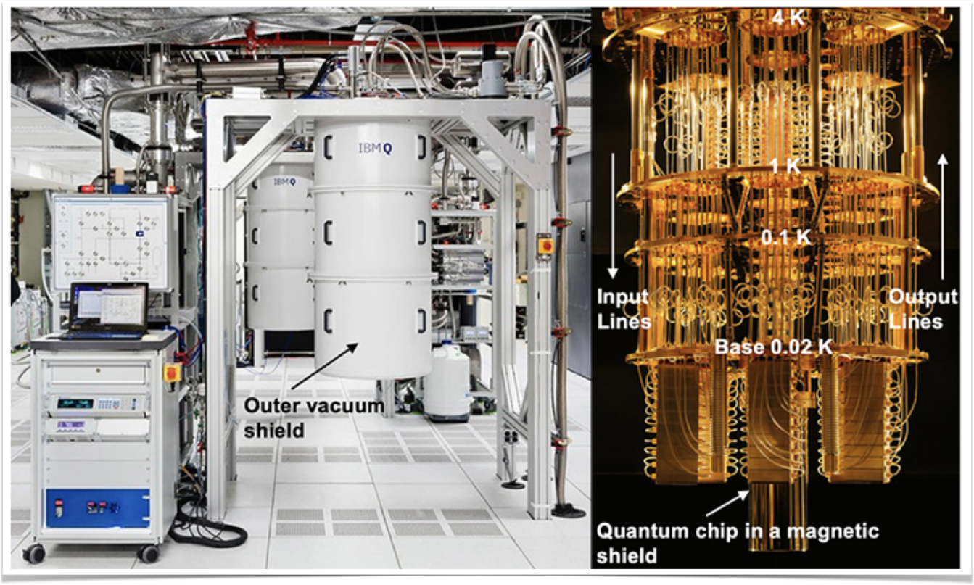
IBM’s Quantum Computer
Notes:
Quantum computers are machines that use the properties of quantum physics to store data and perform computations. This can be extremely advantageous for certain tasks where they could vastly outperform even our best supercomputers.

Slide 3
DiVincenzo’s criteria
Constructing a quantum computer requires that the experimental setup meet he following conditions
A scalable physical system with well characterised qubit
The ability to initialise the state of the qubits to a simple fiducial state, such as |000...⟩
Long relevant decoherence times, much longer than the gate operation time
A "universal" set of quantum gates
A qubit-specific measurement capability

Slide 4
Qiskit
Qiskit is an open-source SDK for working with quantum computers at the level of pulses, circuits and application modules
Designed to work with IBM’s quantum processors
Qiskit webpage - https://qiskit.org

Slide 5
Setup Qiskit
Install Anaconda Python - https://www.anaconda.com/products/individual
Start Anaconda Prompt
Install qiskit by typing "pip install qiskit”
Start Jupyter notebook by typing “jupyter notebook”
Demo

Slide 6
Get Access to Quantum Computers
Get access token from IBM Quantum Experience -
https://quantum-computing.ibm.com
Setup Access token in Qiskit
Demo
Source
Notes:
http://localhost:8888/notebooks/Documents/Qiskit/Presentation/Programs/IBMQ-account.ipynb

Slide 7

Single Qubit Quantum state
Can be written as: $|ψ⟩=α|0⟩+β|1⟩α,β∈C$
Probability of the bit being in $|0⟩$ is $|α|^{2}$ and $|1⟩$ is $|β|^{2}$$⇒$$|α|^{2}+|β|^{2}=1$
Vector notation of $\begin{aligned}|ψ⟩=(\begin{aligned}α \\ β\end{aligned})\end{aligned}⇒\begin{aligned}|0⟩=(\begin{aligned}1 \\ 0\end{aligned})\end{aligned},\begin{aligned}|1⟩=(\begin{aligned}0 \\ 1\end{aligned})\end{aligned}$
From $|α|^{2}+|β|^{2}=1$ and since global phase is undetectable$|ψ⟩:=e^{iδ}|ψ⟩$
$$|ψ⟩=e^{iδ}\left(cos(θ/2)|0⟩+sin(θ/2)e^{i(ϕ-δ)}|1⟩\right)$$
$$⇒$$$$|ψ⟩=cos(θ/2)|0⟩+sin(θ/2)e^{iϕ}|1⟩$$
$$0≤ϕ<2π,0≤θ≤π$$
Bloch sphere representation of qubit state

Slide 8
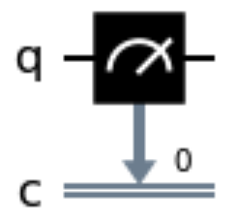
Measurement operator
Make once time measurement on a qubit
Records the result in classical bit

Slide 9
Running Hello World
Writing ‘Hello World’ program
Visualising the program
Running ‘Hello World’ program on Simulator
Running ‘Hello World’ program on Quantum Computer
Demo
Source
Notes:
http://localhost:8888/notebooks/Documents/Qiskit/Presentation/Programs/HelloWorld.ipynb

Slide 10
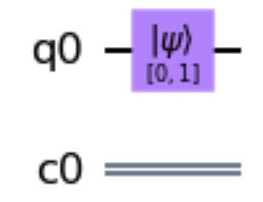
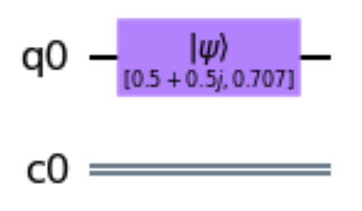
Initialise qubit state
In Qiskit we can specify the initial state of a qubit
Let’s remind the Bloch representation of a qubit that will be used in the examples
$$|ψ⟩=α|0⟩+β|1⟩=cos(θ/2)|0⟩+sin(θ/2)e^{iϕ}|1⟩$$
Example 1
Initialise qubit in state $|1⟩=0|0⟩+1|1⟩$ $⇒$ $α=0,β=1$ $⇒$$θ=π,0≤ϕ<2π$
Example 2
Initialise qubit in state $|ψ⟩=\left(\frac{1}{2}+\frac{1}{2}i\right)|0⟩+\frac{\sqrt{2}}{2}|1⟩=e^{i\frac{π}{4}}\left(\frac{\sqrt{2}}{2}|0⟩+\frac{\sqrt{2}}{2}e^{-i\frac{π}{4}}|1⟩\right)$ $⇒$ $θ=\frac{π}{2},ϕ=-\frac{π}{4}$
Demo
Source
Notes:
http://localhost:8888/notebooks/Documents/Qiskit/Presentation/Programs/QubitInitaisation.ipynb

Slide 11
Quantum gates/operations
A gate which acts on a qubit is represented by a $2×2$ unitary matrix $U$: $|ψ^{′}⟩=U|ψ⟩$
A general unitary must be able to take the $|0⟩$ to the state$|ψ⟩=cos(θ/2)|0⟩+sin(θ/2)e^{iϕ}|1⟩=U|0⟩$
$⇒$ $U=\left(\begin{matrix}cos(θ/2) & a \\ e^{iϕ}sin(θ/2) & b\end{matrix}\right)$, where $a$ and $b$ are complex numbers such that $U^{†}U=I$
The general expression of $2×2$ unitary matrix, which depends on 4 real parameters, is:
$U=\left(\begin{matrix}α & -e^{-iφ}β^{*} \\ β & e^{-iφ}α^{*}\end{matrix}\right),|α|^{2}+|β|^{2}=1$
This is the most general form of single quit unitary, if we substitute above $φ=-λ-ϕ$
$$U=\left(\begin{matrix}cos(θ/2) & -e^{iλ}sin(θ/2) \\ e^{iϕ}sin(θ/2) & e^{iλ+iϕ}cos(θ/2)\end{matrix}\right),0≤ϕ<2π,0≤θ≤π,0≤λ<2π$$

Slide 12
Why quantum operations are represented as unitary matrix?
Schrödinger equation
$\frac{d}{dt}|ψ(t)⟩=-\frac{i}{ℏ}\overset{̂}{H}(t)|ψ(t)⟩$,
where Hamiltonian $\overset{̂}{H}(t)$ is Hermitian operator $\overset{̂}{H}(t)={\overset{̂}{H}}^{†}(t)$
Suppose $|ψ(t)⟩=\overset{̂}{U}(t)|ψ(0)⟩$ for some matrix $\overset{̂}{U}(t)$ which is not unitary yet
$$\frac{d\overset{̂}{U}(t)}{dt}=-\frac{i}{ℏ}\overset{̂}{H}(t)\overset{̂}{U}(t),\frac{d{\overset{̂}{U}}^{†}(t)}{dt}=-\frac{i}{ℏ}\overset{̂}{H}(t)\overset{̂}{U}(t)$$
At $t=0,\overset{̂}{U}(0)=\overset{̂}{I}$, so ${\overset{̂}{U}}^{†}(0)\overset{̂}{U}(0)=\overset{̂}{I}$
$$\frac{d}{dt}\left({\overset{̂}{U}}^{†}(t)\overset{̂}{U}(t)\right)=\frac{1}{ℏ}{\overset{̂}{U}}^{†}(t)\left(i\overset{̂}{H}(t)-i\overset{̂}{H}(t)\right)\overset{̂}{U}(t)=0$$
So ${\overset{̂}{U}}^{†}(t)\overset{̂}{U}(t)=\overset{̂}{I}$ at all times $t$, and $\overset{̂}{U}(t)$ must always be unitary.

Slide 13
Single-Qubit Gates
u gates
$U$ gate $u3(θ,ϕ,λ)=u(θ,ϕ,λ)$
$P$ gate $p(λ)=\left(\begin{matrix}1 & 0 \\ 0 & e^{iλ}\end{matrix}\right)=u3(0,0,λ)$
Identity gate $Id=\left(\begin{matrix}1 & 0 \\ 0 & 1\end{matrix}\right)=u3(0,0,0)$
Pauli gates
$X:$ bit-flip gate $X=\left(\begin{matrix}0 & 1 \\ 1 & 0\end{matrix}\right)=u3(π,0,π)$
$Y:$ bit- and phase-flip gate $Y=\left(\begin{matrix}0 & -i \\ i & 0\end{matrix}\right)=u3(π,π/2,π/2)$
$Z:$ phase-flip gate $Z=\left(\begin{matrix}1 & 0 \\ 0 & -1\end{matrix}\right)=u3(0,0,π)$
Clifford gates
Hadamard gate $H=\frac{1}{\sqrt{2}}\left(\begin{matrix}1 & 1 \\ 1 & -1\end{matrix}\right)=u3(0,0,π)$
$S$ gate $S=\left(\begin{matrix}1 & 0 \\ 0 & i\end{matrix}\right)=u3(0,0,π/2)$
$S^{†}$ gate $S^{†}=\left(\begin{matrix}1 & 0 \\ 0 & -i\end{matrix}\right)=u3(0,0,-π/2)$
$C3$ gate
$T$ gate $T=\left(\begin{matrix}1 & 0 \\ 0 & e^{iπ/4}\end{matrix}\right)=u3(0,0,π/4)$
$T^{†}$ gate $T^{†}=\left(\begin{matrix}1 & 0 \\ 0 & e^{-iπ/4}\end{matrix}\right)=u3(0,0,-π/4)$
Standart Rotations
Rotation around X-axis
$$R_{x}(θ)=\left(\begin{matrix}cos(θ/2) & -isin(θ/2) \\ -isin(θ/2) & cos(θ/2)\end{matrix}\right)=u3(θ,-π/2,π/2)$$
Rotation around Y-axis
$$R_{y}(θ)=\left(\begin{matrix}cos(θ/2) & -sin(θ/2) \\ sin(θ/2) & cos(θ/2)\end{matrix}\right)=u3(θ,0,0)$$
Rotation around Z-axis
$$R_{z}(ϕ)=\left(\begin{matrix}e^{-iϕ/2} & 0 \\ 0 & e^{iϕ/2}\end{matrix}\right)≡u3(0,ϕ,0)$$

Slide 14
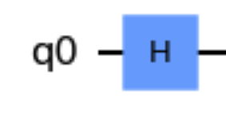
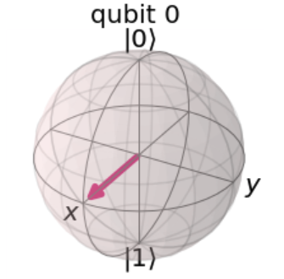
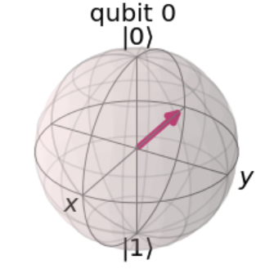
Hadamard Gate
Considering$\begin{aligned}|0⟩=(\begin{aligned}1 \\ 0\end{aligned})\end{aligned},\begin{aligned}|1⟩=(\begin{aligned}0 \\ 1\end{aligned})\end{aligned}$, and $H=\frac{1}{\sqrt{2}}\left(\begin{matrix}1 & 1 \\ 1 & -1\end{matrix}\right)$
Let’s apply $H$-gate on state vector $|0⟩:$
$$H|0⟩=\frac{1}{\sqrt{2}}\left(\begin{matrix}1 & 1 \\ 1 & -1\end{matrix}\right)\left(\begin{aligned}1 \\ 0\end{aligned}\right)=\frac{1}{\sqrt{2}}\left(\begin{aligned}1 \\ 1\end{aligned}\right)=\frac{1}{\sqrt{2}}\left(\begin{aligned}1 \\ 0\end{aligned}\right)+\frac{1}{\sqrt{2}}\left(\begin{aligned}0 \\ 1\end{aligned}\right)=\frac{1}{\sqrt{2}}|0⟩+\frac{1}{\sqrt{2}}|1⟩$$
$$⇒α=\frac{1}{\sqrt{2}},β=\frac{1}{\sqrt{2}}$$$$⇒|α|^{2}=0.5,|β|^{2}=0.5$$
Demo
Source
Notes:
http://localhost:8888/notebooks/Documents/Qiskit/Presentation/Programs/HadamardGate.ipynb

Slide 15
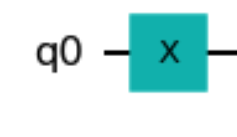
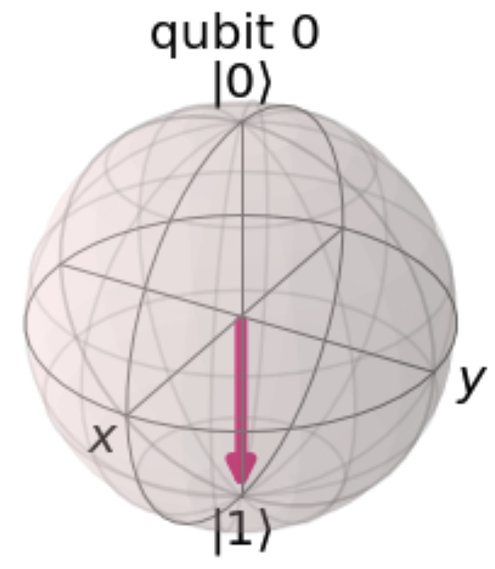
X-Gate
Considering$\begin{aligned}|0⟩=(\begin{aligned}1 \\ 0\end{aligned})\end{aligned},\begin{aligned}|1⟩=(\begin{aligned}0 \\ 1\end{aligned})\end{aligned}$, and $X=\left(\begin{matrix}0 & 1 \\ 1 & 0\end{matrix}\right)$
Let’s apply $X$-gate on state vector $|0⟩:$
$$X|0⟩=\left(\begin{matrix}0 & 1 \\ 1 & 0\end{matrix}\right)\left(\begin{aligned}1 \\ 0\end{aligned}\right)=\left(\begin{aligned}0 \\ 1\end{aligned}\right)=0|0⟩+1|1⟩$$
$$⇒α=0,β=1$$
$$⇒|α|^{2}=0,|β|^{2}=1$$
Demo
Source
Notes:
http://localhost:8888/notebooks/Documents/Qiskit/Presentation/Programs/XGate.ipynb#

Slide 16
Multi and Two-qubit system
For $n$ qubits the complex vector space has dimensions $d=2^{n}$ - grows exponentially with the number of qubits
The basis vectors for the 2-qubit system are formed using the tensor product of basis vectors for a single qubit:$\begin{matrix}|0⟩⊗|0⟩=|00⟩ & =\left(\begin{aligned}1(\begin{aligned}1 \\ 0\end{aligned}) \\ 0(\begin{aligned}1 \\ 0\end{aligned})\end{aligned}\right)=\left(\begin{aligned}1 \\ 0 \\ 0 \\ 0\end{aligned}\right)|0⟩⊗|1⟩=|01⟩=\left(\begin{aligned}1(\begin{aligned}0 \\ 1\end{aligned}) \\ 0(\begin{aligned}0 \\ 1\end{aligned})\end{aligned}\right)=\left(\begin{aligned}0 \\ 1 \\ 0 \\ 0\end{aligned}\right)\end{matrix}$$\begin{aligned}|1⟩⊗|0⟩=|10⟩=(\begin{aligned}0(\begin{aligned}1 \\ 0\end{aligned}) \\ 1(\begin{aligned}1 \\ 0\end{aligned})\end{aligned})=(\begin{aligned}0 \\ 0 \\ 1 \\ 0\end{aligned})|1⟩⊗|1⟩=|11⟩=(\begin{aligned}0(\begin{aligned}0 \\ 1\end{aligned}) \\ 1(\begin{aligned}0 \\ 1\end{aligned})\end{aligned})=(\begin{aligned}0 \\ 0 \\ 0 \\ 1\end{aligned})\end{aligned}$
$|ψ⟩=a_{00}|00⟩+a_{01}|01⟩+a_{10}|10⟩+a_{11}|11⟩=\left[\begin{aligned}a_{00} \\ a_{01} \\ a_{10} \\ a_{11}\end{aligned}\right]$, $|a_{00}|^{2}+|a_{01}|^{2}+|a_{10}|^{2}+|a_{11}|^{2}=1$
Demo
Source
Notes:
http://localhost:8888/notebooks/Documents/Qiskit/Presentation/Programs/Two-qubitState.ipynb

Slide 17
Two-qubit Gates - General Form
Most of the two-qubit gates are of the controlled type (except for the SWAP gate)
Controlled type two-qubit gates applies $U$ to one qubit, conditioned on the state of another qubit
Lets apply on one qubit 1 the gate $U$ on condition qubit 0 is equal to $|1⟩$, where $U=\left(\begin{matrix}u_{00} & u_{01} \\ u_{10} & u_{11}\end{matrix}\right)$
$$\begin{aligned}\begin{matrix}C_{U}:\underset{\text{qubit}1}{|0⟩}⊗\underset{\text{qubit}0}{|0⟩} & →\underset{\text{qubit}1}{|0⟩}⊗\underset{\text{qubit}0}{|0⟩} \\ C_{U}:\underset{\text{qubit}1}{|0⟩}⊗\underset{\text{qubit}0}{|1⟩} & →\underset{\text{qubit}1}{U|0⟩}⊗\underset{\text{qubit}0}{|1⟩} \\ C_{U}:\underset{\text{qubit}1}{|1⟩}⊗\underset{\text{qubit}0}{|0⟩} & →\underset{\text{qubit}1}{|1⟩}⊗\underset{\text{qubit}0}{|0⟩} \\ C_{U}:\underset{\text{qubit}1}{|1⟩}⊗\underset{\text{qubit}0}{|1⟩} & →\underset{\text{qubit}1}{U|1⟩}⊗\underset{\text{qubit}0}{|1⟩}\end{matrix}\end{aligned}$$
when Controlled bit is MSB: $C_{U}=\left(\begin{matrix}1 & 0 & 0 & 0 \\ 0 & u_{00} & 0 & u_{01} \\ 0 & 0 & 1 & 0 \\ 0 & u_{10} & 0 & u_{11}\end{matrix}\right)$
when Controlled bit is LSB: $C_{U}=\left(\begin{matrix}1 & 0 & 0 & 0 \\ 0 & 1 & 0 & 0 \\ 0 & 0 & u_{00} & u_{01} \\ 0 & 0 & u_{10} & u_{11}\end{matrix}\right)$
LSB
MSB

Slide 18
Two-Qubit Gates
Controlled Pauli gates
Controlled-X - flips the target qubit if the control qubit is in the state $|1⟩$. Controlled-bit MSB: $C_{X}=\left(\begin{matrix}1 & 0 & 0 & 0 \\ 0 & 1 & 0 & 0 \\ 0 & 0 & 0 & 1 \\ 0 & 0 & 1 & 0\end{matrix}\right)$, LSB: $C_{X}=\left(\begin{matrix}1 & 0 & 0 & 0 \\ 0 & 0 & 0 & 1 \\ 0 & 0 & 1 & 0 \\ 0 & 1 & 0 & 0\end{matrix}\right)$
Controlled-Y gate
Controlled-bit MSB: $C_{Y}=\left(\begin{matrix}1 & 0 & 0 & 0 \\ 0 & 1 & 0 & 0 \\ 0 & 0 & 0 & -i \\ 0 & 0 & i & 0\end{matrix}\right)$, LSB: $C_{Y}=\left(\begin{matrix}1 & 0 & 0 & 0 \\ 0 & 0 & 0 & -i \\ 0 & 0 & 1 & 0 \\ 0 & i & 0 & 0\end{matrix}\right)$
Controlled-Z - flips the phase of the target qubit if the control qubit is in the state $|1⟩$. Controlled-bit MSB or LSB: $C_{Z}=\left(\begin{matrix}1 & 0 & 0 & 0 \\ 0 & 1 & 0 & 0 \\ 0 & 0 & 1 & 0 \\ 0 & 0 & 0 & -1\end{matrix}\right)$
Hadamard gate - LSB: $C_{H}=\left(\begin{matrix}1 & 0 & 0 & 0 \\ 0 & \frac{1}{\sqrt{2}} & 0 & \frac{1}{\sqrt{2}} \\ 0 & 0 & 1 & 0 \\ 0 & \frac{1}{\sqrt{2}} & 0 & -\frac{1}{\sqrt{2}}\end{matrix}\right)$
Controlled rotation gates
Controlled rotation around Z-axis $C_{Rz}(λ)=\left(\begin{matrix}1 & 0 & 0 & 0 \\ 0 & e^{-iλ/2} & 0 & 0 \\ 0 & 0 & 1 & 0 \\ 0 & 0 & 0 & e^{iλ/2}\end{matrix}\right)$
Controlled Phase rotation - performs a phase rotation if both qubits are in the state $|11⟩$
$$C_{p}(λ)=\left(\begin{matrix}1 & 0 & 0 & 0 \\ 0 & 1 & 0 & 0 \\ 0 & 0 & 1 & 0 \\ 0 & 0 & 0 & e^{iλ}\end{matrix}\right)$$
Controlled-U rotation $C_{u}(θ,ϕ,λ)≡\left(\begin{matrix}1 & 0 & 0 & 0 \\ 0 & e^{-i(ϕ+λ)/2}cos(θ/2) & 0 & -e^{-i(ϕ-λ)/2}sin(θ/2) \\ 0 & 0 & 1 & 0 \\ 0 & e^{i(ϕ-λ)/2}sin(θ/2) & 0 & e^{i(ϕ+λ)/2}cos(θ/2)\end{matrix}\right)$
SWAP gate - It transforms the basis vectors as
$$|00⟩→|00⟩,|01⟩→|10⟩,|10⟩→|01⟩,|11⟩→|11⟩,$$
$$SWAP=\left(\begin{matrix}1 & 0 & 0 & 0 \\ 0 & 0 & 1 & 0 \\ 0 & 1 & 0 & 0 \\ 0 & 0 & 0 & 1\end{matrix}\right)$$

Slide 19
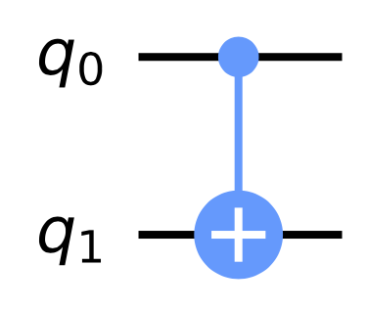
CNOT Gate
CNOT (Controlled-X) Gate
When the qubits are not in superposition of $|0⟩$ and $|1⟩$, they behave like classical bits and for the CNOT gate the following truth table is valid:
CNOT gate matrices:
$${\text{CNOT}}_{\text{MSB}}=\left[\begin{matrix}1 & 0 & 0 & 0 \\ 0 & 1 & 0 & 0 \\ 0 & 0 & 0 & 1 \\ 0 & 0 & 1 & 0\end{matrix}\right]{\text{CNOT}}_{\text{LSB}}=\left[\begin{matrix}1 & 0 & 0 & 0 \\ 0 & 0 & 0 & 1 \\ 0 & 0 & 1 & 0 \\ 0 & 1 & 0 & 0\end{matrix}\right]$$
The matrix swaps the amplitudes of $|01⟩$ and $|11⟩$ vectors|a⟩=a00a01a10a11,CNOT|a⟩=a00a11a10a011←1←
Input | Output
00 | 00
01 | 11
10 | 10
11 | 01
Demo
Source
Notes:
http://localhost:8888/notebooks/Documents/Qiskit/Presentation/Programs/Entanglement.ipynb#

Slide 20
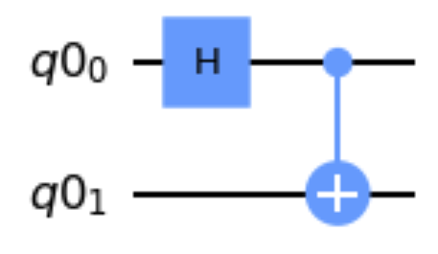
Entanglement
Entanglement implements with the following circuit
Demo
Source
Notes:
http://localhost:8888/notebooks/Documents/Qiskit/Presentation/Programs/Entanglement.ipynb#

Slide 21
Quantum Algorithms
Quantum Fourier Tranformation
Quantum Phase Estimation
Shor’s Algorithm
Variational Quantum Eigensolver

Slide 22
Quantum Fourier Tranform (QFT)
Quantum Fourier transform acts on a quantum state $|X⟩=\overset{N-1}{\underset{j=0}{∑}}x_{j}|j⟩$ and maps it to the quantum state $|Y⟩=\overset{N-1}{\underset{k=0}{∑}}y_{k}|k⟩$, according to the formula:
$y_{k}=\frac{1}{\sqrt{N}}\overset{N-1}{\underset{j=0}{∑}}x_{j}ω_{N}^{jk}$, where $ω_{N}^{jk}=e^{2πi\frac{jk}{N}}$
This can also be expressed as unitary matrix:
$$U_{QFT}=\frac{1}{\sqrt{N}}\overset{N-1}{\underset{j=0}{∑}}\overset{N-1}{\underset{k=0}{∑}}ω_{N}^{jk}|k⟩⟨j|$$

Slide 23
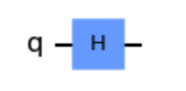
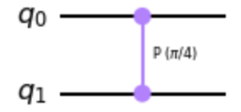
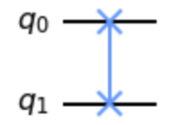
QFT implementation
Needed operators:
H-Gate
Controlled Phase Gate
SWAP Gate

Slide 24
Controlled Phase Gate in two-qubit system
Performs a phase rotation if both qubits are in the state $|11⟩$
$$C_{p}(λ)=\left(\begin{matrix}1 & 0 & 0 & 0 \\ 0 & 1 & 0 & 0 \\ 0 & 0 & 1 & 0 \\ 0 & 0 & 0 & e^{iλ}\end{matrix}\right)$$
Demo
Source
Notes:
http://localhost:8888/notebooks/Documents/Qiskit/Presentation/Programs/CP-Gate.ipynb

Slide 25
QFT Demos
Source
QFT Example for 1-qubit system
QFT Example for 2-qubit system
Source
Demo
Notes:
http://localhost:8888/notebooks/Documents/Qiskit/Presentation/Programs/QFT-OneQubit.ipynb
http://localhost:8888/notebooks/Documents/Qiskit/Presentation/Programs/QFT-TwoQubits.ipynb
http://localhost:8888/notebooks/Documents/Qiskit/Presentation/Programs/QFT-ThreeQubits.ipynb

Slide 26
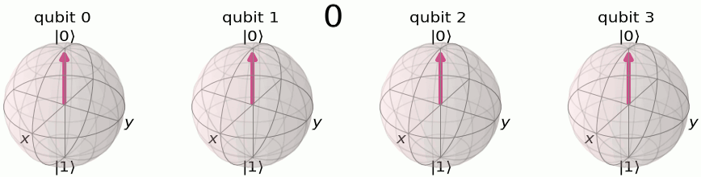
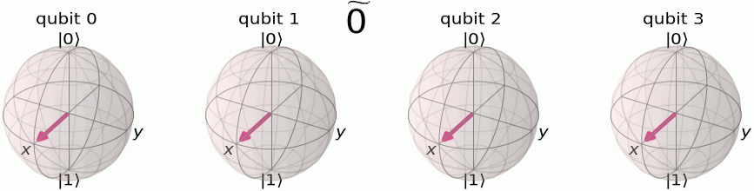
QFT with 4 qubits

Slide 27
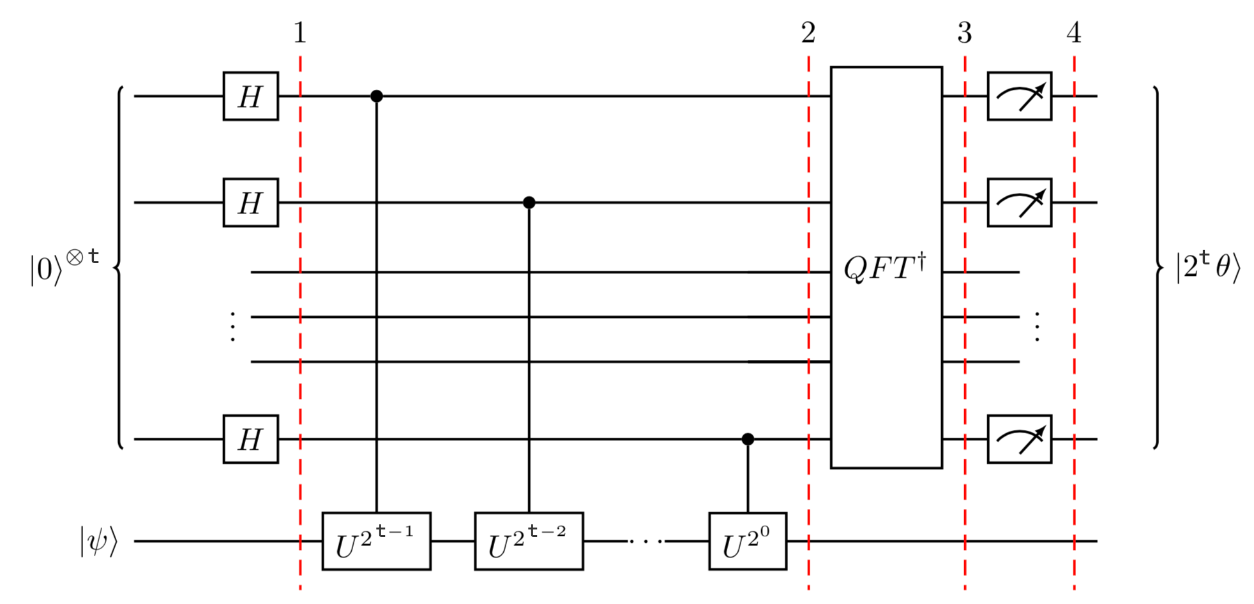
Quantum Phase Estimation
Given a unitary operator $U$, the algorithm estimates $θ$ in $U|ψ⟩=e^{2πiθ}|ψ⟩$, where $|ψ⟩$ is an eigenvector and $e^{2πiθ}$ is the corresponding eigenvalue
Demo
Source
Notes:
http://localhost:8888/notebooks/Documents/Qiskit/Presentation/Programs/QPE.ipynb

Slide 28
Simulating Molecules using VQE
In the future Quantum Phase Estimation may be useful to find Eigen values of Hermitian matrix
In 2014, Peruzzo et al. proposed Variational Quantum Eigensolver (VQE) method to estimate the ground state energy of molecule
Given a Hermitian matrix $H$ with unknown minimum eigenvalue $λ_{min}$ and eigenstate $|ψ_{min}⟩$, VQE provides an estimate $λ_{θ}$ bounding $λ_{min}$:
$$\begin{aligned}λ_{min}≤λ_{θ}≡⟨ψ(θ)|H|ψ(θ)⟩\end{aligned}$$
where $|ψ(θ)⟩$ is eigenstate associated with $λ_{θ}$.
If we apply $U(θ)$ to some arbitrary starting state $|ψ⟩$, we can obtain an estimate $U(θ)|ψ⟩≡|ψ(θ)⟩$ on $|ψ_{min}⟩$
Using classical controller the algorithm iteratively minimise the expectation value of $⟨ψ(θ)|H|ψ(θ)⟩$
Demo
Source

Slide 29
Resources
The first part of the presentation is mostly based on:
https://qiskit.org/documentation/tutorials/circuits/3_summary_of_quantum_operations.html
Second part is based on:
https://qiskit.org/textbook/ch-algorithms/index.html
Useful Tutorial:
https://www.youtube.com/watch?v=a1NZC5rqQD8&list=PLOFEBzvs-Vvp2xg9-POLJhQwtVktlYGbY
Find the presentation and examples on:
https://drive.google.com/drive/folders/1Dwh8zK2YD2cu3BWt-2HO0DQGvrYv2PfH?usp=sharing

Slide 30
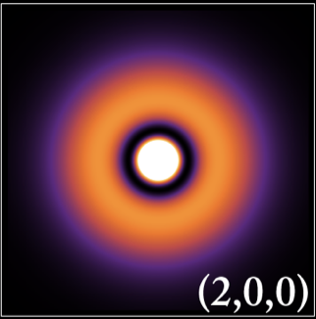
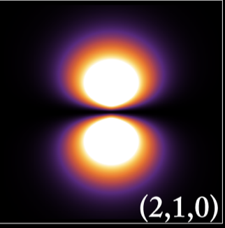
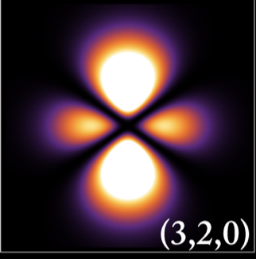
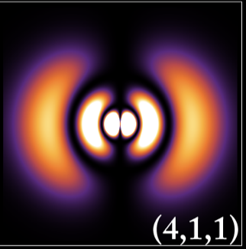
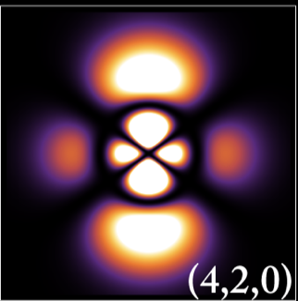
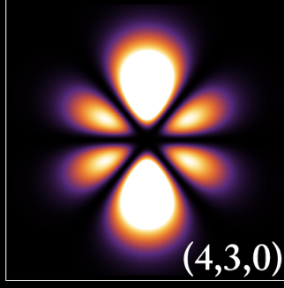
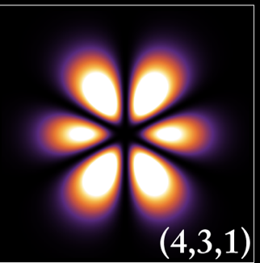
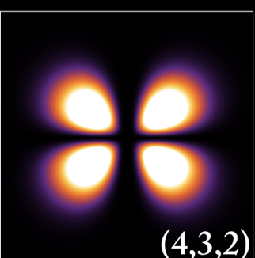
Thank you!

